Slide 1

Average Cost of Undergraduate Education in the USA

Slide 2
Data Analysts:
Anthony Pino
Debra Mcnulty
Nema Aragones
Robert Bellgraph

Slide 3

This research study will answer the following questions:
Introduction: Given an opportunity, people want to pursue college education for various reasons. The reason might be getting a high-paying job, developing skills, increase job opportunities just to name a few. There are other mixture of reasons for an individual in going to college. But let’s face the reality, that the expenses (tuition, room & board) often get in the way.
Project Title: Average Cost of Undergraduate Education in the USA
Project Description:
This project will look at the data from year 2013-2021 on the average cost of college in the USA by state, type of institution, length of study, and year. It will assist in providing a deeper understanding on the financials of undergraduate education across the US. Specifically, it will contribute to answering common questions listed below if one is evaluating going to college.
Notes:
Research Questions to Answer:
Plot 2019 - We start off with 1st question that was during the pandemic (COV-19), what’s the education cost during a pandemic time. Then we’re gonna compare that with the next slide.
----------------------
What’s the:
Where in the US can a family find the most Affordable education for a four-year undergrad education.
We present in out mapping both Privat and Public. 2 year and 4 year
2 year and 4 year
Can we see a true variance from the Covid Pandemic
Is Public In State or Out of Sate or Private schools more economical.
****** POSSIBLE NEEDS*****
2021 Bar - can we add color to the highest 5 and lowest and possibly add the dollars in the ends
Possible top by themselves
Questions on Data:

Slide 4

This research study will answer the following questions:
Which 5 states had the lowest & highest average tuition fees in a public out-of-state and private institution for year 2021 and what is the percentage from the lowest and the highest cost ?
Is there a significant greater cost between Private an Public Education.
Can one afford to get a 4-year undergraduate degree with a budget of $10000 per year on expenses (tuition & room/board)?
On the map, can we see the locations that present where I can assess the states to choose a college?
What type of institution would one go to on a tight budget to pursue an undergraduate education? And is is best to start with a 2 year and then move to a 4 year?
What kind do the higher brackets looks like for the more expensive schools and what part of the states have the most schools?
Evaluation to determine if Covid had an Impact to lessen the standard increase
Notes:
Research Questions to Answer:
Plot 2019 - We start off with 1st question that was during the pandemic (COV-19), what’s the education cost during a pandemic time. Then we’re gonna compare that with the next slide.
----------------------
What’s the:
Where in the US can a family find the most Affordable education for a four-year undergrad education.
We present in out mapping both Privat and Public. 2 year and 4 year
2 year and 4 year
Can we see a true variance from the Covid Pandemic
Is Public In State or Out of Sate or Private schools more economical.
****** POSSIBLE NEEDS*****
2021 Bar - can we add color to the highest 5 and lowest and possibly add the dollars in the ends
Possible top by themselves
Questions on Data:

Slide 5
All Plots present: ****** Not part of Presentation and Requires update ********
2019 Average Fees/Tuition Cost of a 4 Year Public Education
2021 Average Fees/Tuition Cost of a 4 Year Public Education
2019/2021 State Cost Comparison 4 year public education
2019 Average Fees/Tuition of a 2 Year Public Education
2021 Average Fees/Tuition of a 2 Year Public Education
2019/2021 State Cost Comparison 2 year public education
2021 State Cost Comparison of a 2 and 4 Year Public Education
2021 Average Fees/Tuition Cost of a Private Education
2021 State Cost Comparison of a Private and Public Education
Undergraduate average cost per type of institution
Average Cost by year trend
Tuition By School Type
Tuition By State
Distribution of Institutions By Sector
Distribution of Institutions By Type
5 Year Tuition Avg By State
Total Cost by Year for All Schools
Total Cost by Year for Private Schools
Total Cost by Year – In State
Total Cost by Year – Out of State
Display the ff.:
2021 Map of Fees/Tuition per state (Public 4-Year)
2021 Map of Fees/Tuition per state (Private 4-Year)
Notes:
Research Questions to Answer:

Slide 6
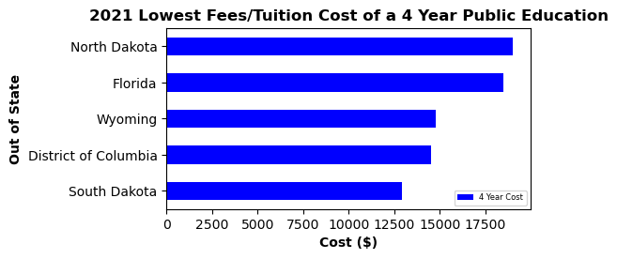
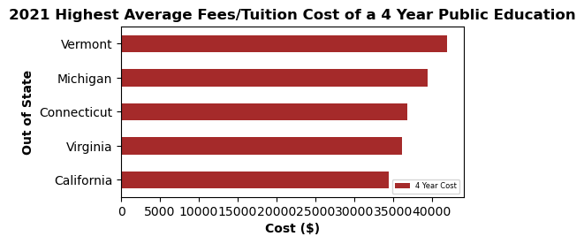
2021 Average Fees/Tuition Cost of a 4 Year Out of state Public Education
Five lowest cost states for a 4 year public education (2021) 1. South Dakota ($12,924)
2. District of Columbia ($14,540) 3. Wyoming ($14,803) 4. North Dakota ($18,514) 5. New Mexico ($19,021)
Five highest cost states for a 4 year public education (2021) 1. Vermont ($41,963) 2. Michigan ($39,427)
3. Connecticut($36,881) 4. Virginia ($36,881) 5. California ($34,398)
Analysis: There’s a difference of $29,039 between the highest and lowest avg tuition which is a 224.69% increase cost from the lowest to the highest in tuition in an out-of-state 4 year public education in 2021.

Slide 7
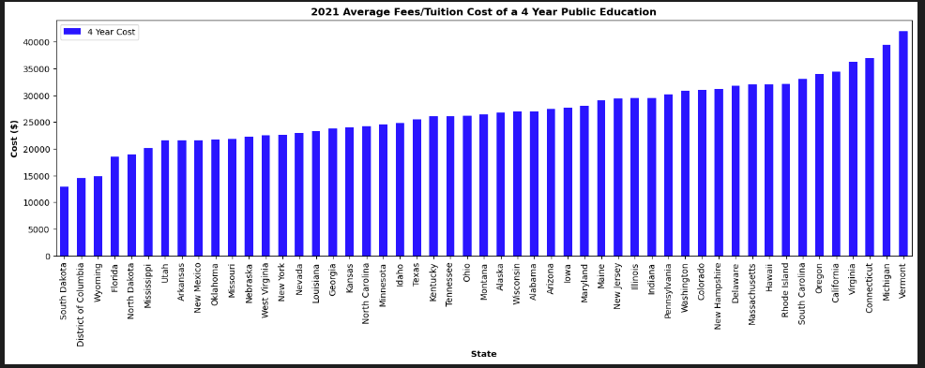
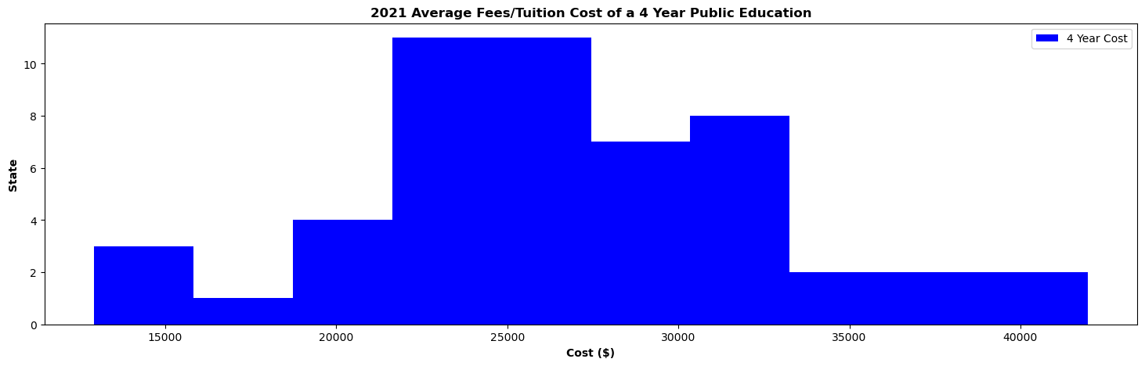
Analysis: We can see in this plot the lowest to the highest and below in this histogram we can see the typical bins that the cost represents.
Within the low to high ranges, the mean is $26,711but the typical budget show between $22k and $33K for a Public 4 year Education.

Slide 8
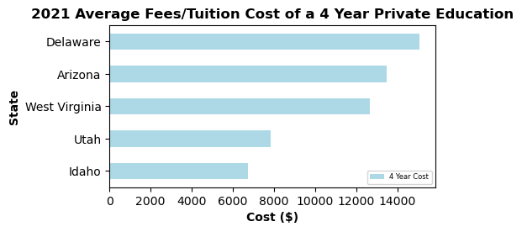
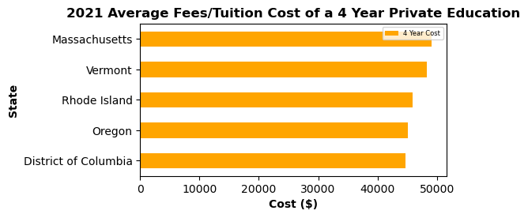
2021 Average Fees/Tuition Cost of a 4 Year Private Education
Five lowest cost states for a 4 year public education (2021) 1. Idaho($6,752)
2. Utah($7,852) 3. West Virginia ($12,673) 4. Arizona($13,487) 5. Delaware($15,096)
Five highest cost states for a 4 year public education (2021) 1. Massachusetts ($ 49,152) 2. Vermont ($ 48,300)
3. Rhode Island ($ 45,927) 4. Oregon ($ 45,166) 5. District of Columbia ($ 44,692)
Analysis: There’s a difference of $42,400 between the highest and lowest avg tuition which is a 627.96% increase cost from the lowest to the highest in tuition in an out-of-state 4-year private education in 2021.

Slide 9
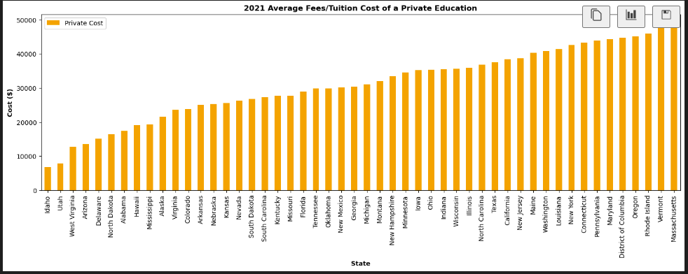
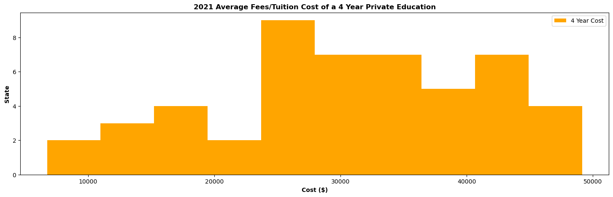
Analysis:
Like the public schools.
Within the low to high ranges, we have a mean of $30,949 but see typical ranges of $25K to $37K for Private 4 year.

Slide 10
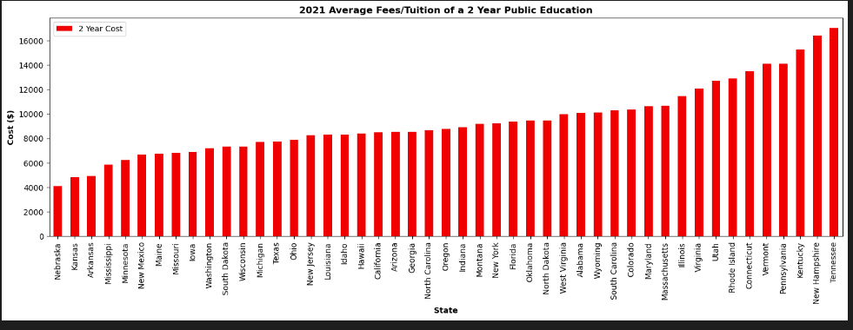
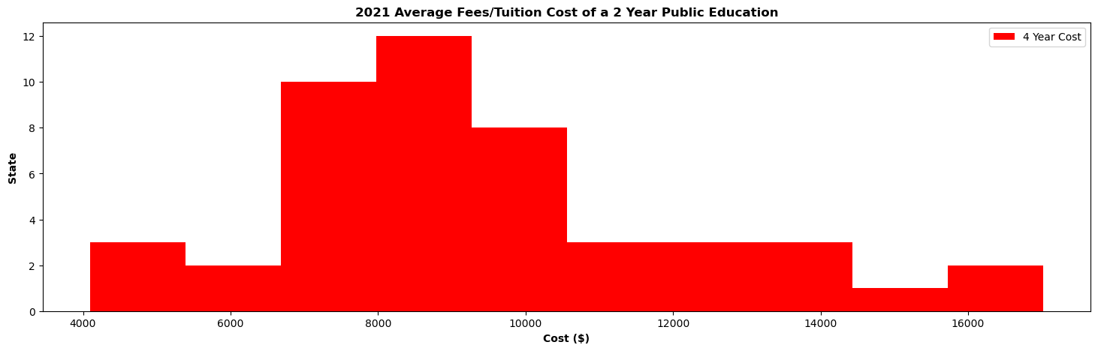
Analysis:
2 Year Public.
Average 2 year $9397 but has a typical ranges from $7k to $10.5K

Slide 11
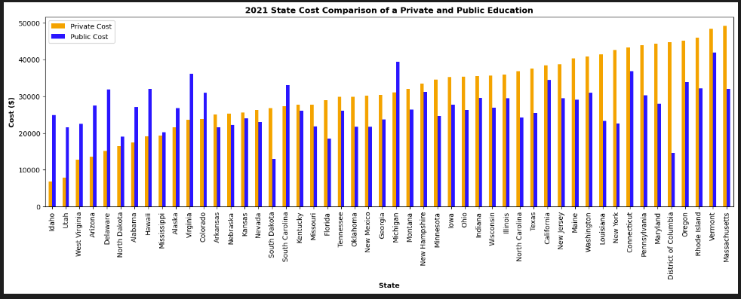
Analysis:
We can see here that the states vary in preference from Private to Public. About 73% of the states have a higher cost for Private Education than they do for a Public Education.
Our average for private is $30949 and for public it is $26,949, however only a $4000 variance.

Slide 12
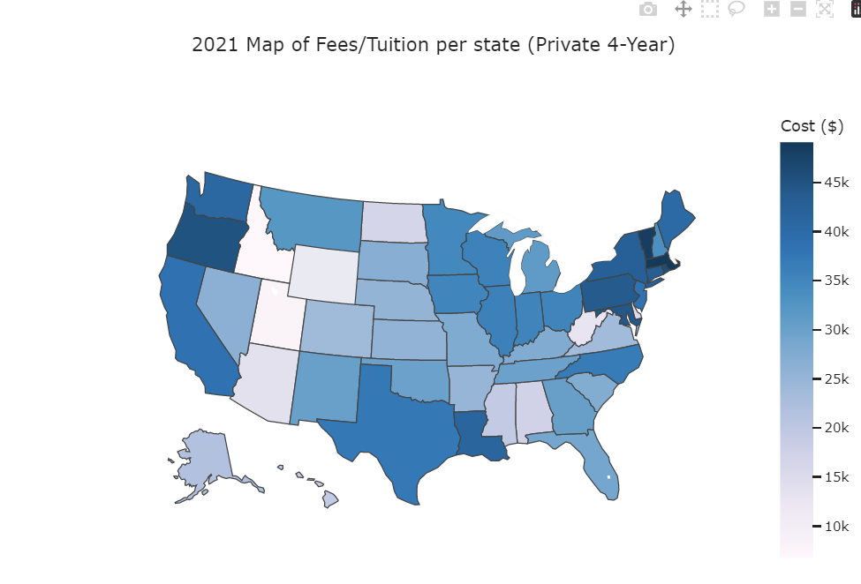
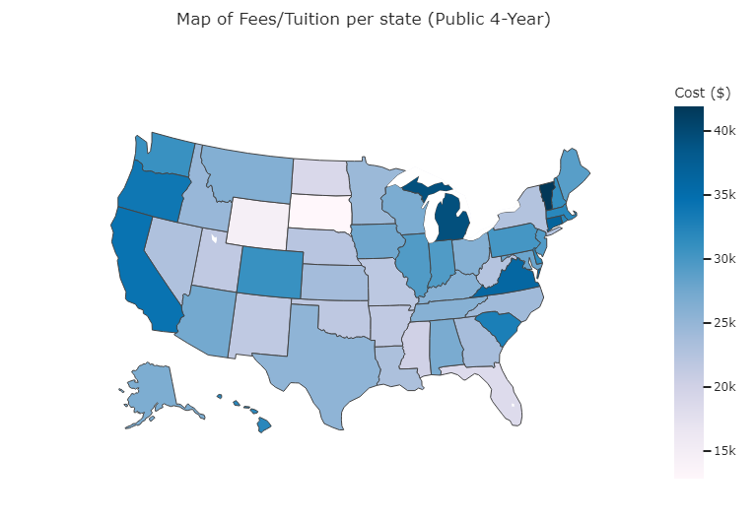
In this heat map we are looking at 4-year Private and 4-Year Public. We can see by this map the that the highest cost overall represented by the far northeast to northern states surrounding the big lakes then down to Texas and surrounding states and up the coast of California.

Slide 13
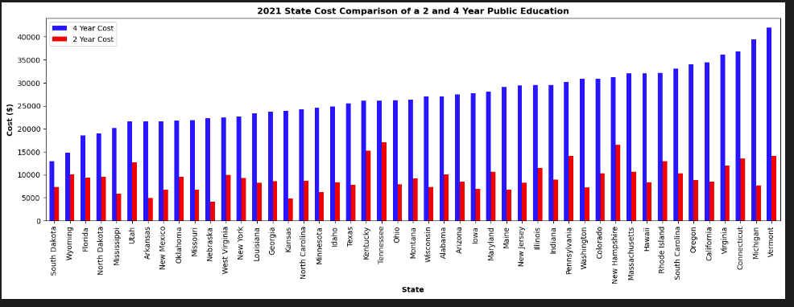
Analysis:
This bar is a great representation for the starting block of education and looking the standard income level using the 2 years education cost as springboard to get the education started and using the first 2 years to get the basics covered at a much lower cost.
The Average for a 2 year education is $9397 and the average of a 4 year is $26939 and is a 65% difference. Good option to start with the 2 and finish the four or greater.

Slide 14
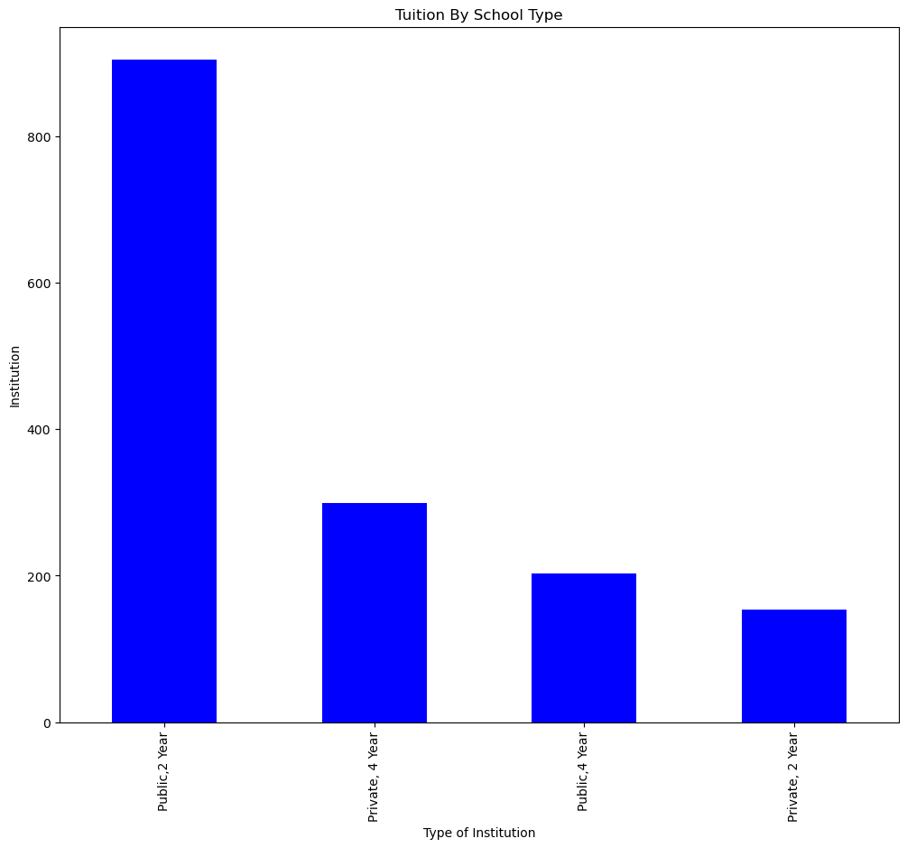
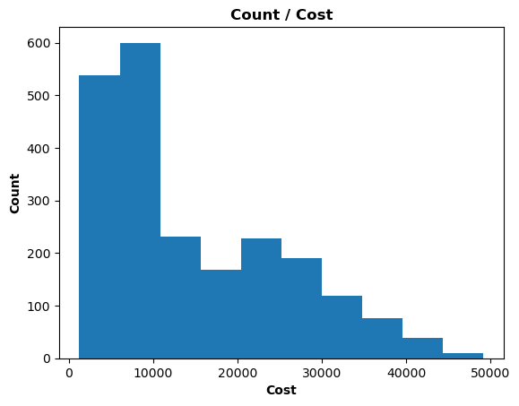
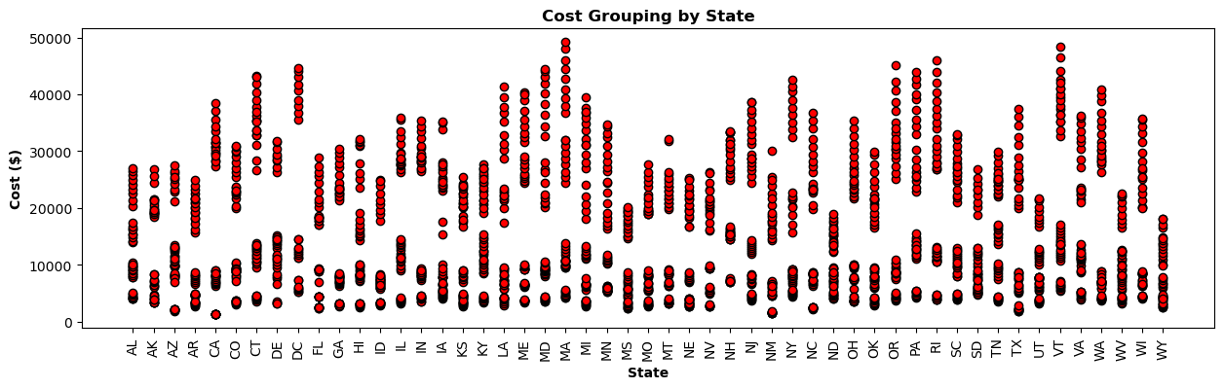
Analysis:
We have the group of plat that give a good representation of overall cost and we you would get started. The 2 year presents the lower costs even from a second dataset that has been analyzed using a 5-year average. We can see in the red scatter plot the cluster of $7 to $10K and then around the $28K marker again as we get to a 4yr.

Slide 15
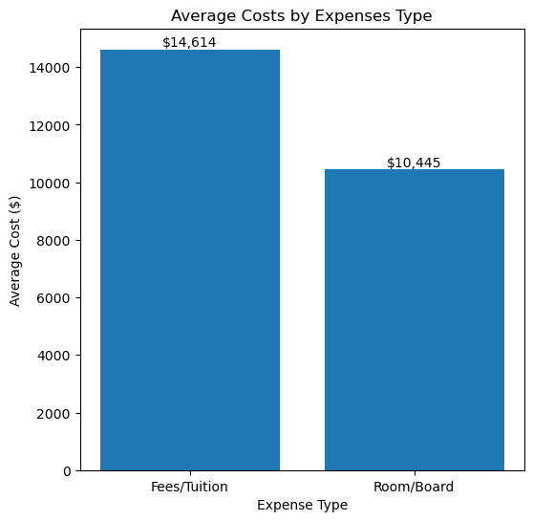
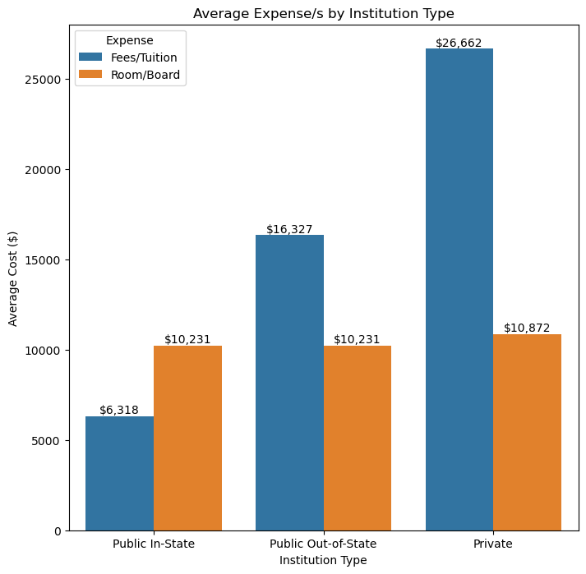
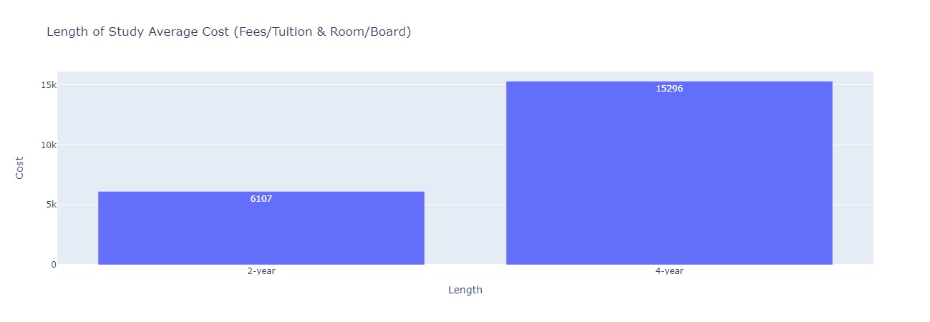
Analysis:
This slides represents the difference in the expenses between room and board and the Fee/Tuition. Average from 2013 to 2021
We do see that that data may be missing information and will need further research However we wanted to present this as we can see an overall picture that the Room/Board will a big cost and will present opportunities to got to school in the state you live in near the home if a budget is needed.

Slide 16
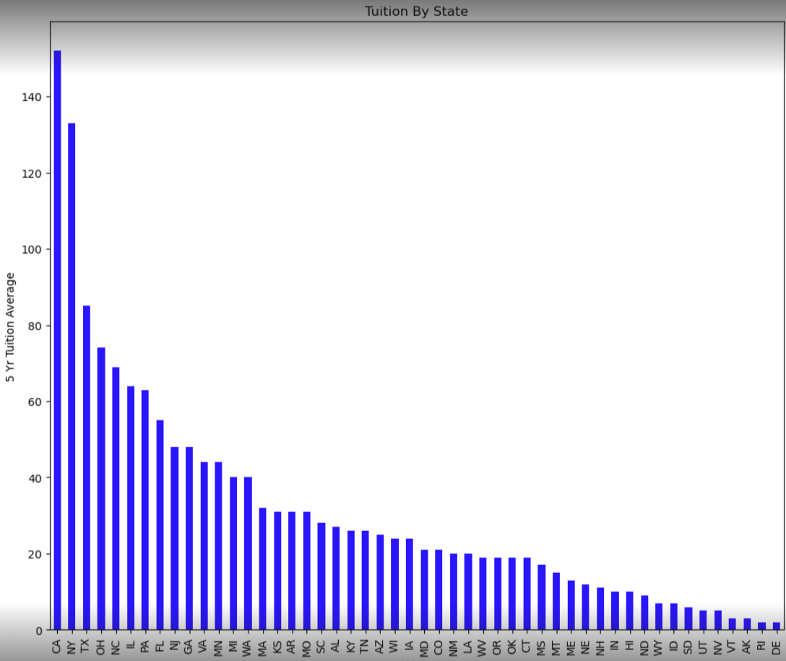
Analysis:
We bring a new dataset for perspective.
In this sector we wanted to give a representation of the cost without excluding the more costly schools. School cost have a great amount of range. As we look at this plot we see cost from below $10K to over $140K on a 5 years average from 2017 to 2021. Each school present a different opportunity and does mean you have to spend the greatest dollar to be a Success.

Slide 17
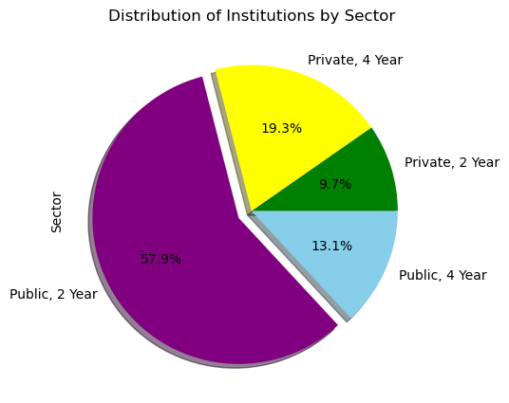
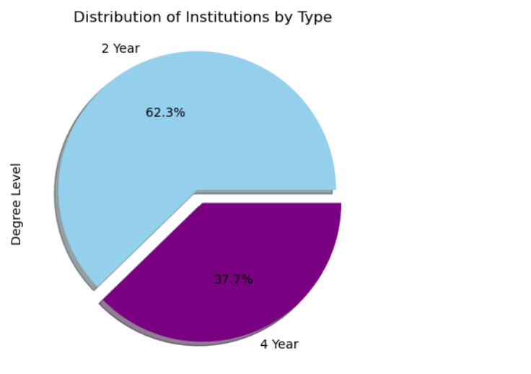
Analysis:
As we seen in the charts above the 2 years is represented as the greatest sector and may be likely to be due to the costs involved. Would love to get into more data on the difference including Bootcamps and Online learning programs.

Slide 18
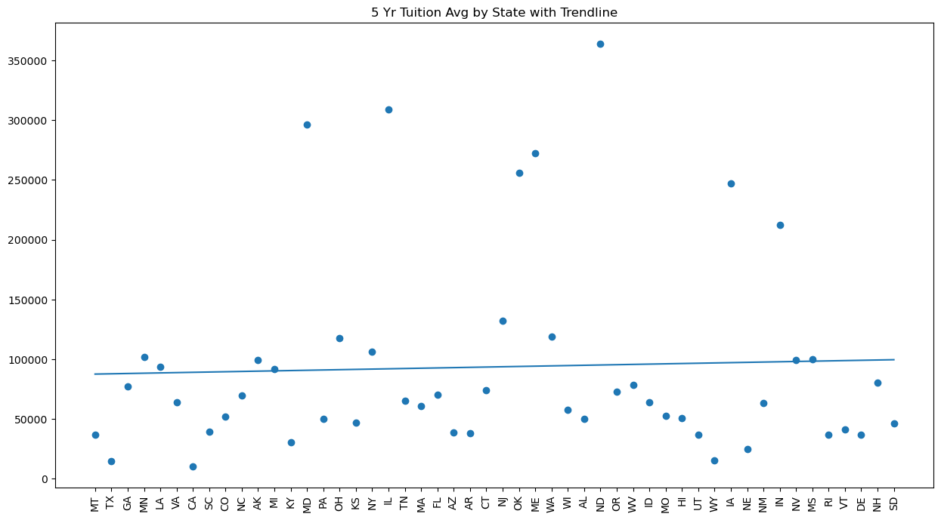
Analysis:
This chart represents a 5 year tuition average by state. We can see here with the trendline there is a slight trend upward.

Slide 19
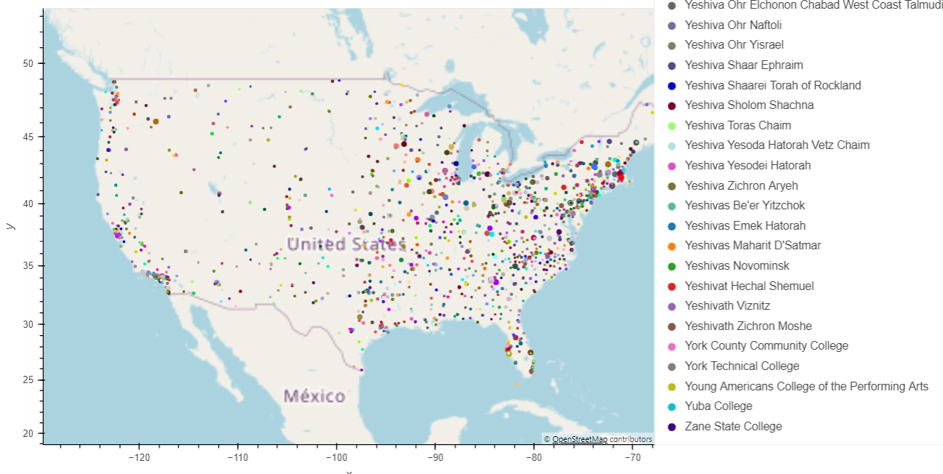
Analysis:
This shows represent 5 years average tuition mean by statement and the US and can give us direction to what side of the country has the most represented colleges.

Slide 20
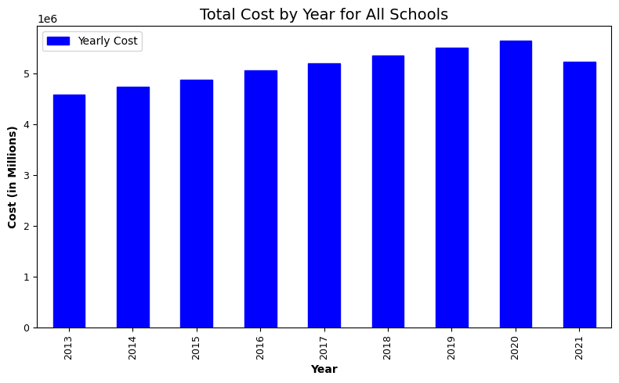
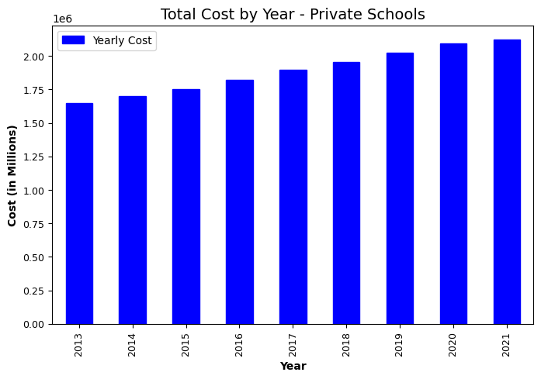
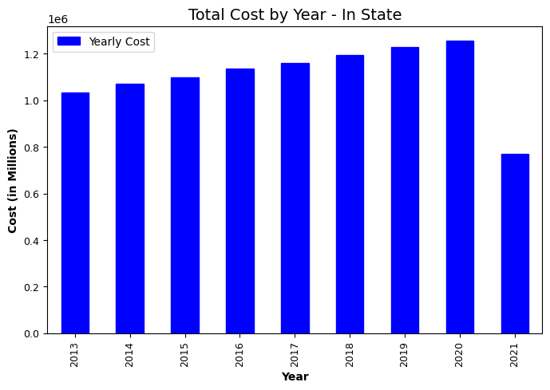
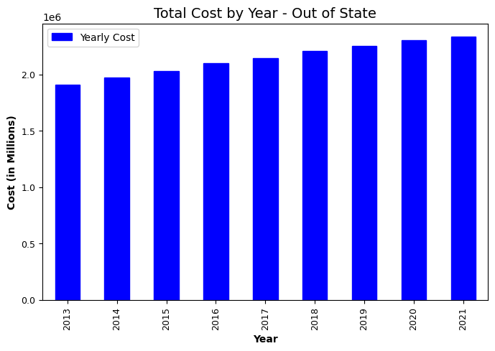
Analysis:
COVID IMPACT
Start of the Covid information. We have multiple set charts to represent whether Covid had any impact to lover the cost of school. In these for the the next 4 on the next slide there are Total Cost and Total fees. We can see that it appears to have made an impact. However…

Slide 21
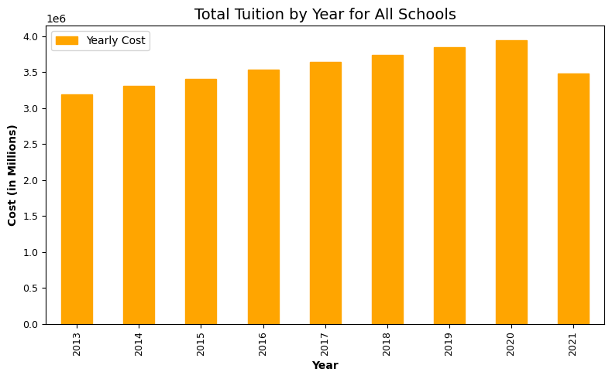
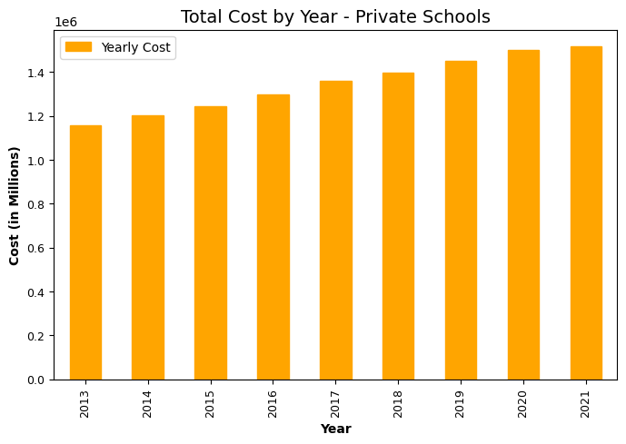
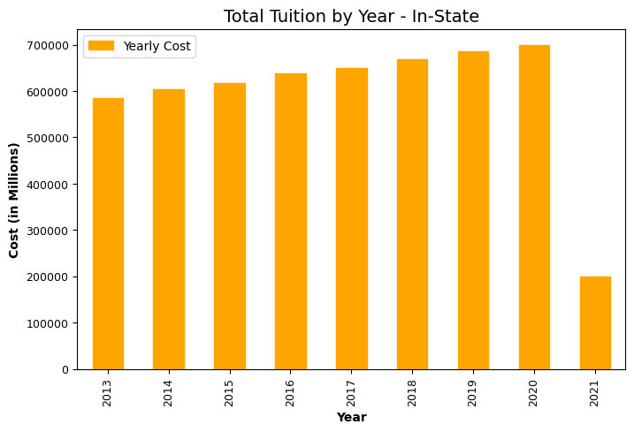
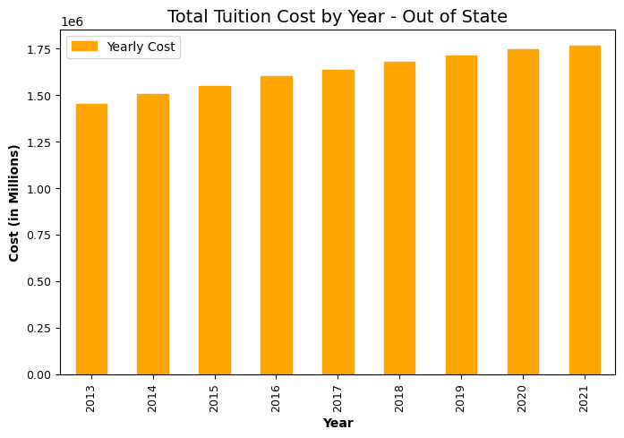
Analysis:
COVID IMPACT
As we look here there is significant decrease that raises the question, is there a challenge with the data. As we dug deeper, we found missing information on In-State Public Schools that skewed the data. We decided to keep these slides because the do represent a upward trend from 2013-2021 and 20 on 2 of them. Thus going into Covid Season and still trending the same.
Further Research Necessary

Slide 22
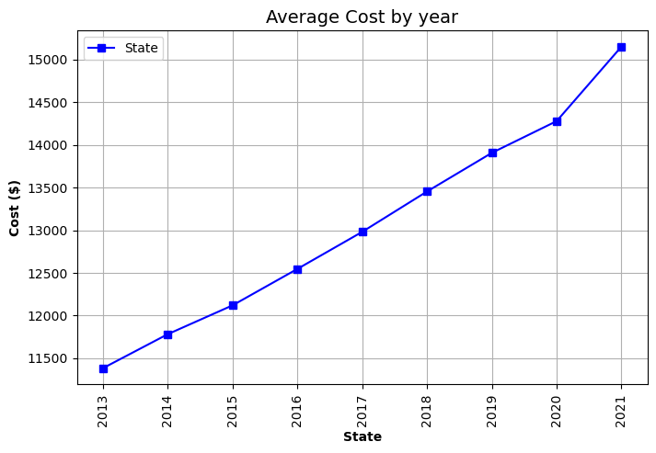
Analysis:
COVID IMPACT
The average by state still has a trending line indicating trend remaining up.

Slide 23
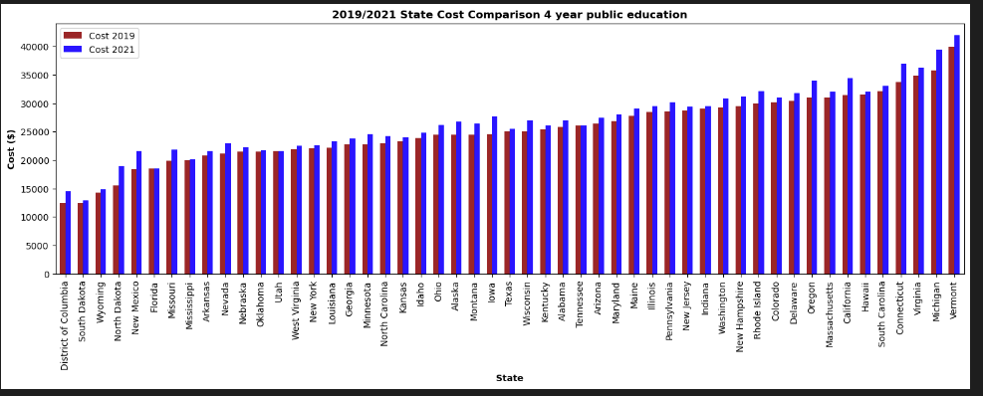
Analysis:
COVID IMPACT
This chart represent the overall cost average for 2019 and 2021 years that Covid had just started and the year Covid was in full impact.
We can see by this trend that all States averages continued to increase even as covid was in full force.
We will see in the next slide the percentage of increases from 2019 to 2021for out of states 4 year for reference.

Slide 24
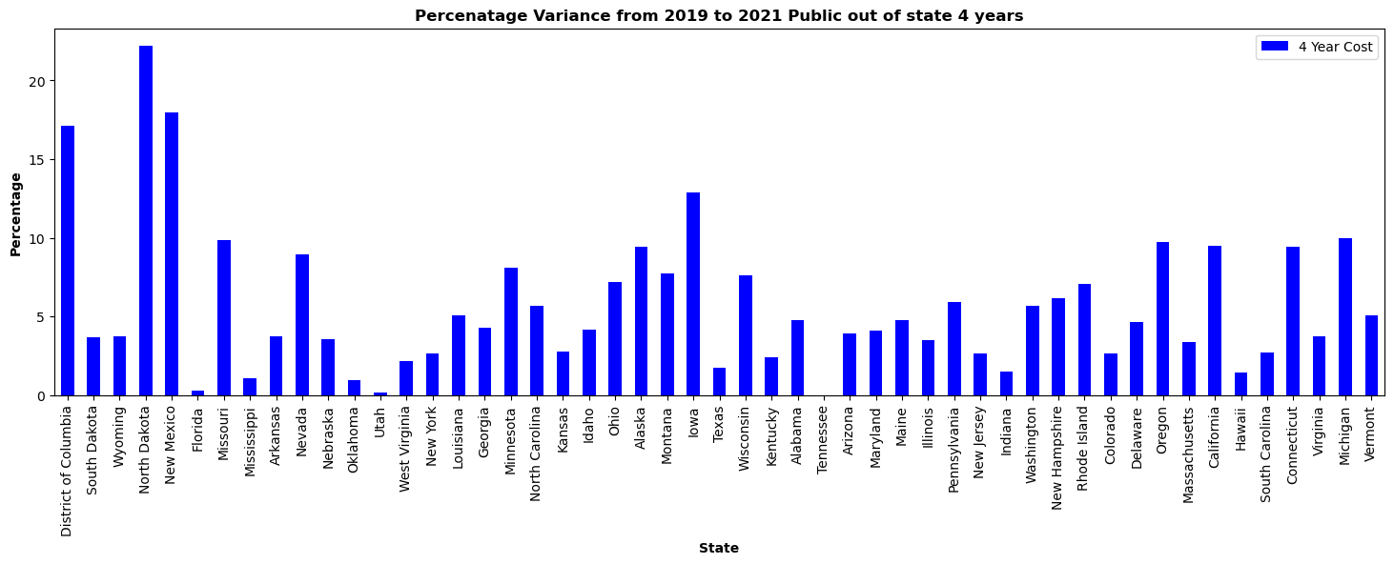
Analysis:
COVID IMPACT
Here we have percentage of increase ranging from 0 to over 20% from 2019 to 2020.

Slide 25
Conclusion
Which 5 states had the lowest & highest average tuition fees in a public out-of-state institution year 2021 and what is the percentage from the lowest and the highest cost ?
Public
Highest Average - Vermont ($41,963) Michigan ($39,427) Connecticut($36,881) Virginia ($36,881) California ($34,398)
Lowest Average - South Dakota ($12,924) District of Columbia ($14,540) Wyoming ($14,803) North Dakota ($18,514) New Mexico ($19,021)
Private
Highest - Massachusetts ($ 49,152) Vermont ($ 48,300) Rhode Island ($ 45,927) Oregon ($ 45,166) District of Columbia ($ 44,692)
Lowest- Idaho($6,752) Utah($7,852) West Virginia ($12,673) Arizona($13,487) Delaware($15,096)
Is there a significant greater cost between Private an Public Education.
Private does have a great cost indicated however based on the mean it is only about a $4000 variance. Our average for private is $30949 and for public it is $26,949.
Can one afford to get a 4-year undergraduate degree with a budget of $10000 per year on expenses (tuition & room/board)?
Yes, based on the analysis a person does have options for a 4 years degree in some states but they are minimal and private. We can see public schools showing starting about $12K.
On the map, can we see the locations that present where I can assess the states to choose a college?
Yes the heat map gives us indicators of cost and where you would typically find lower and higher cost for schools.
What type of institution would one go to on a tight budget to pursue an undergraduate education?
And is it best to start with a 2 year and then move to a 4 year? Based on the analysis the 2 years has a lower cost overall and may be the best place to start on a budget and move to a 4 years if funds are increasing and budget can sustain.
What does higher priced school look like and how much more expensive are they and what part of the states have the most schools?
We can see costs for higher priced schools with pricing range over $100K annually and even greater than $140K. You can see on the map that school are over but more abundant in the Middle, East and far West States.
Evaluation to determine if Covid had an Impact to lessen the standard increase: Based on the data that we have here we do not see an impact for any decrease in school costs. More data may over additional conclusions but as of today, no impact. Only increases from year to year.

